Slide 1
Introduction to Computer Programming Lecture 11.3:
Review : Functions, Reading and Writing Files
Hemma Philamore
Department of Engineering Mathematics

Slide 2



Functions
Cleaner code : easier to understand and maintain.
Shorter
More reusable
Some code
Some code
function def
Some other code
other function def
Call function
Some code
Some code
call other function
Some other code
Some code
Functions have to be defined before called!

Slide 3
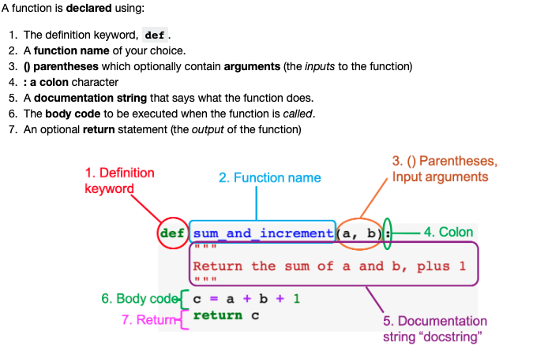
Function definition checklist

Slide 4
Q.11.3.A
Write a function, is_even.
Input:
n (integer)
Output:
True if n is even
False if n is not even
Q.11.3.B
Write a function to calculate gravitational potential energy of an object:
Input:
m (mass)
g (acceleration due to gravity)
h (height)
Output:
gravitational potential energy, E = mgh
m
g
h

Slide 5
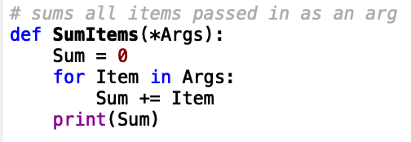

Multiple arguments
Default arguments
Python puts all arguments in a tuple
y and z have
default values
product(1)
>> 20
product(3,z=4)
>> 24
SumItems2(1,2,3)
>> 6
SumItems2(1,2,3,4)
>> 10

Slide 6
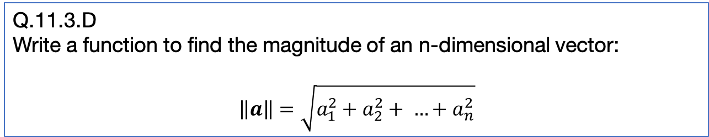
Q.11.3.C
a) Write a function to calculate gravitational potential energy of an object, assuming g=9.81ms⁻² .
(Rewrite your answer to Q11.3.B)
b) Write a function to calculate gravitational potential energy of an object of mass 1kg, assuming g=9.81ms⁻².
m
g
h
Q.11.3.D
Write a function to find the magnitude of an n-dimensional vector:
$$\left\|a\right\|=\sqrt{a_{1}^{2}+a_{2}^{2}+ …+a_{n}^{2}}$$

Slide 7
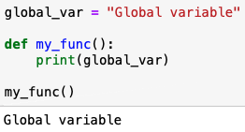
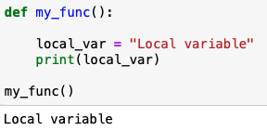
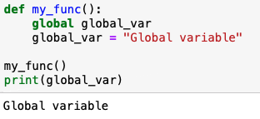
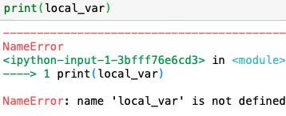
Local and global variables
Global variables
accessible anywhere
Local variables
accessible within function only

Slide 8
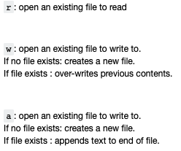
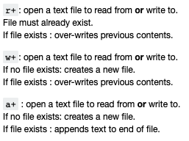
Reading/Writing files
Functions for reading and writing to external files: open, read, write, close
open(file_path, mode_specifier)
Mode Specifiers

Slide 9
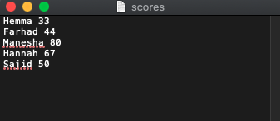

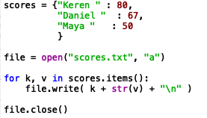
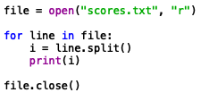
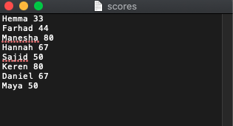

Reading Files
Writing Files
Open returns an iterable object
Open returns an iterable object
Remember to close the file!
Remember to close the file!

Slide 10


Closing Files Automatically
File closes automatically at end of indented code block
File closes automatically at end of indented code block

